Slide 1
E-COMMERCE CUSTOMER CHURN PREDICTION
BY
DEVIKA C (221801009)
KEERTHIKA P (221801027)
LAVANYA S (221801028)

Slide 2
ABSTRACT
Churn prediction is a crucial aspect of customer relationship management in e-commerce, helping businesses identify customers who are likely to discontinue their purchasing activities. This project leverages the CatBoost algorithm, a powerful gradient boosting algorithm, to predict customer churn with high accuracy. By analyzing a wide range of customer data, including purchase history, browsing patterns, and engagement metrics, the model identifies key factors contributing to churn. A comprehensive dashboard is developed to visualize these predictions, providing e-commerce businesses with actionable insights to implement targeted retention strategies.

Slide 3
Introduction and Overview of the Project.
In the dynamic world of e-commerce, retaining customers is vital for sustainable business growth. Customer churn, the process of customers stopping their purchases or disengaging from the platform, can significantly impact a company's bottom line. Predicting churn accurately allows businesses to take preemptive actions to retain at-risk customers, thereby improving customer loyalty and lifetime value.To address this challenge, this project utilizes the CatBoost algorithm, a state-of-the-art gradient boosting technique particularly effective for handling categorical data and missing values, which are common in e-commerce datasets. By analyzing customer behavior and transaction data, the model aims to predict churn with high precision. To enhance usability and facilitate data-driven decisions, a comprehensive dashboard is developed. This dashboard provides visual insights into churn predictions, allowing businesses to quickly identify at-risk customers and understand the underlying factors driving churn. Additionally, a report download feature is integrated, enabling stakeholders to access detailed analyses and insights for further evaluation and strategy development.

Slide 4
Existing System
Logistic regression is a simple yet effective algorithm used for binary classification problems, such as predicting whether a customer will churn or not.
Decision trees split the data into subsets based on feature values, creating a tree-like model to predict churn. Each leaf node represents a churn or non-churn prediction.
Random Forest is an ensemble method that builds multiple decision trees and combines their predictions to improve accuracy and reduce overfitting. It works well with large datasets and can handle complex relationships between features.

Slide 5
Advantages of Existing System
Logistic regression: It offers the advantages of simplicity and interpretability, making it easy to understand and explain predictions. It is highly efficient for binary classification tasks, such as churn prediction
Decision trees : It valued for their intuitive and visual nature, which simplifies interpretation and understanding. They effectively handle both numerical and categorical data and capture non-linear relationships, making them suitable for complex patterns.
Random forest: It enhances prediction accuracy by combining multiple decision trees and is robust against overfitting due to its averaging approach. Additionally, it provides insights into feature importance, highlighting the most influential factors in the model.

Slide 6
Disadvantages of Existing System
Disadvantages of Logistic Regression:
Limited to Linear Relationships: May not capture complex patterns and struggles with imbalanced data.
Disadvantages of Decision Trees:
Prone to Overfitting: Can create overly complex models and be unstable with small data changes.
Disadvantages of Random Forest:
Complex and Resource-Intensive: Difficult to interpret and can be computationally heavy, especially with large ensembles.

Slide 7
Proposed System
The proposed system e-commerce churn prediction system will use the CatBoost algorithm for its high accuracy and effective handling of categorical features and large datasets. CatBoost's gradient boosting approach and ability to manage missing values make it ideal for churn prediction. To complement this, to develop a dashboard that visualizes churn metrics, customer segments, and predictive insights, providing actionable retention strategies and tracking changes over time. This combination will help e-commerce businesses understand and address customer churn more effectively, improving retention and business performance.

Slide 8
Advantages of proposed system
High Accuracy: CatBoost provides precise churn predictions, improving the reliability of the insights.
Efficient Handling of Categorical Features: Simplifies data preprocessing by effectively managing categorical data.
Robust to Overfitting: The algorithm reduces the risk of overfitting, ensuring better generalization to new data.
Comprehensive Dashboard: Visualizes key churn metrics and customer segments, offering actionable insights and tracking trends over time.
Scalable and Interactive: Handles large datasets efficiently and provides interactive features for deeper analysis and real-time updates.

Slide 9
MODULE 1: DATA PREPROCESSING
Handle missing values: Use imputation (mean, median) or remove rows with missing data.
Feature engineering: Create new features like RFM (Recency, Frequency, Monetary).
Categorical encoding: Use Label Encoding or One-Hot Encoding for categorical features.
Outlier detection: Identify and handle outliers using IQR or Z-score methods.
Feature scaling: Standardize/normalize data if needed (especially for non-CatBoost models).
Data cleaning: Remove duplicates and correct inconsistencies in the data.
Prepare data: Output a clean, structured dataset ready for modeling.

Slide 10
MODULE 2: PREDICTION
Train CatBoost model: Use CatBoost for churn prediction, focusing on categorical features.
Data split: Split dataset into training (80%) and testing (20%) sets.
Model training: Train the model with the training data and tune hyperparameters.
Churn prediction: Output churn probabilities for test data (likelihood of churn).
Cross-validation: Use cross-validation for model robustness and avoid overfitting.
Model output: Get final churn predictions and probabilities.
Documentation: Summarize model parameters, training process, and results.

Slide 11
MODULE 3: EVALUATION
Performance metrics: Evaluate using accuracy, precision, recall, F1-score.
Confusion matrix: Visualize true positives, false positives, true negatives, and false negatives.
AUC-ROC curve: Assess model’s ability to discriminate churn vs. non-churn.
Feature importance: Identify key factors contributing to churn predictions.
Model comparison: Compare CatBoost with other models like Logistic Regression and Random Forest.
Cross-validation results: Confirm model stability using k-fold or leave-one-out methods.
Refinement: Use results to adjust and improve the model if necessary.

Slide 12
MODULE 4: WEB INTERFACE
Dashboard overview: Display churn rate, predicted churn probabilities, and metrics.
Customer segmentation: Filter and segment churn predictions by demographics or behavior
.
Retention insights: Visualize factors causing churn (e.g., low engagement, infrequent purchases).
Report download: Provide stakeholders the option to download detailed churn reports.
Interactive predictions: Allow users to input customer data and predict churn probability.
Data visualization: Use Plotly or Dash to present churn data through graphs/charts.
Web integration: Build with Node for backend and interactive front-end.

Slide 13
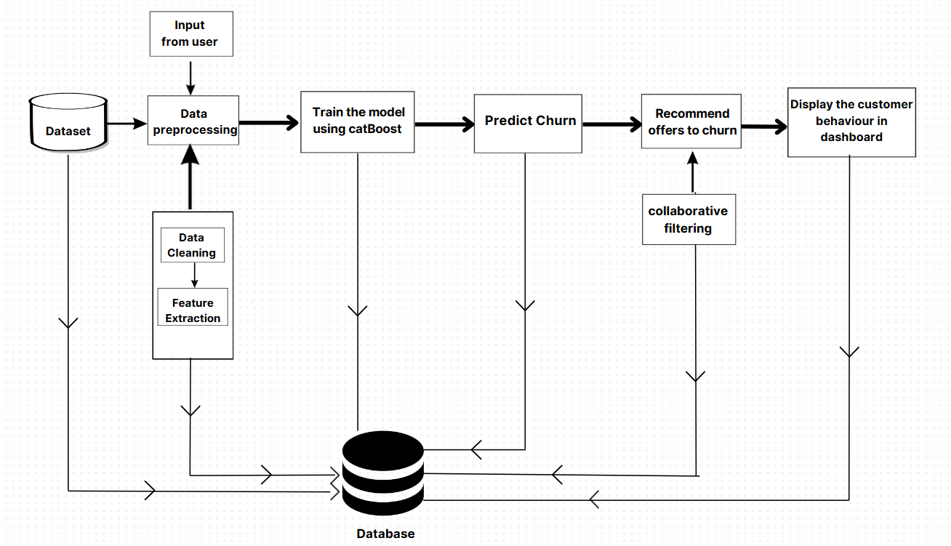
SYSTEM ARCHITECTURE

Slide 14
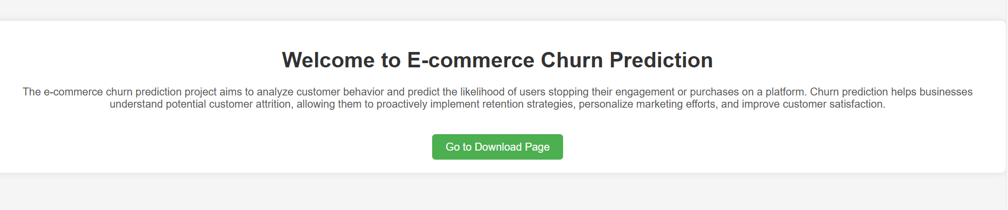
OUTPUT

Slide 15
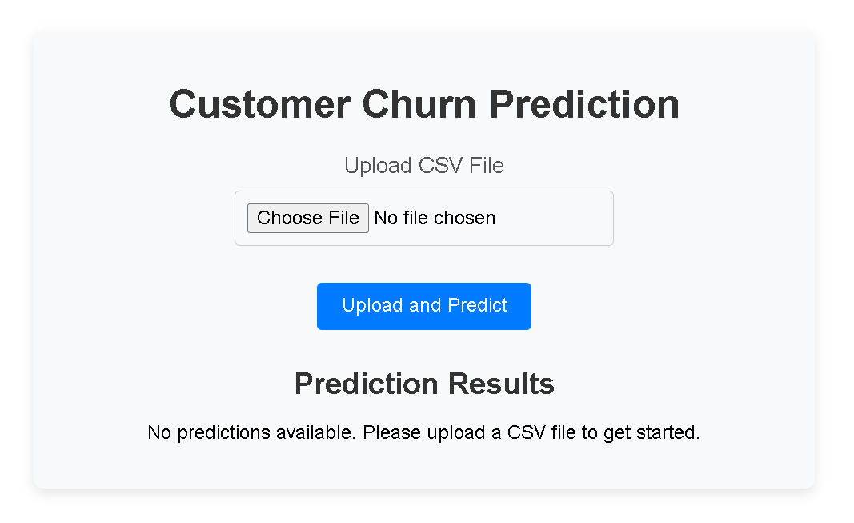
OUTPUT

Slide 16
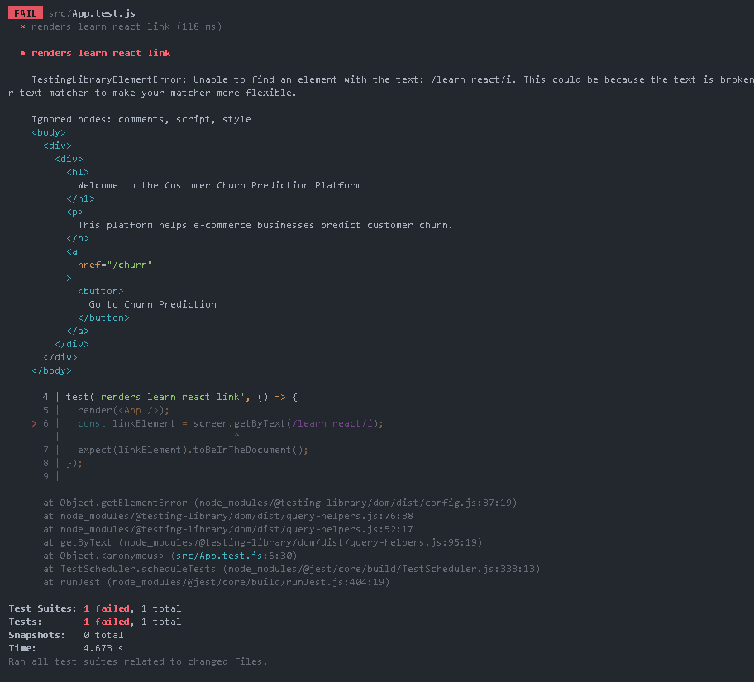
TEST OUTPUT

Slide 17
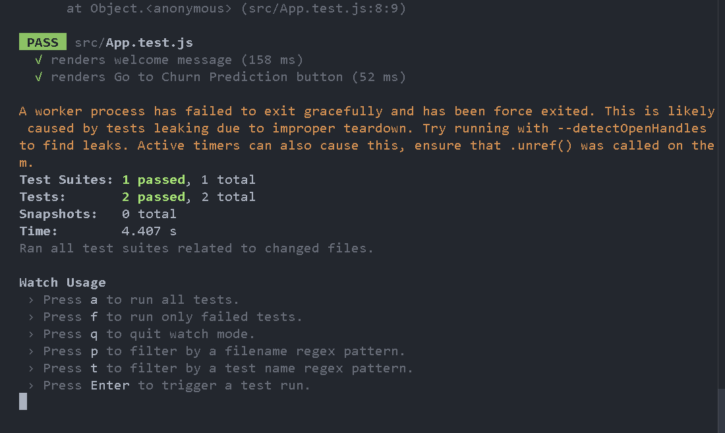
TEST OUTPUT

Slide 18
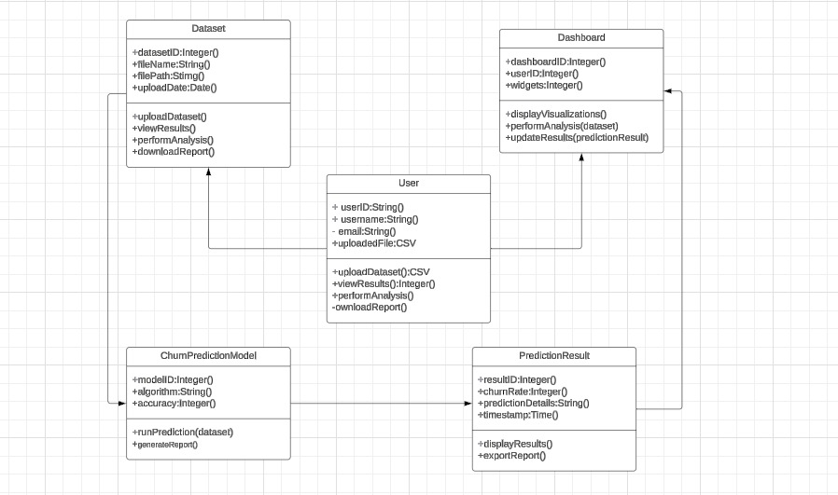
CLASS DIAGRAM

Slide 19
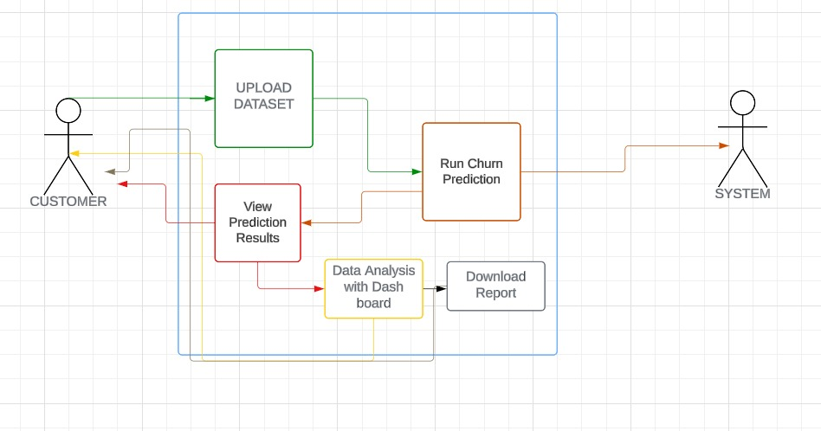
USE CASE DIAGRAM

Slide 20
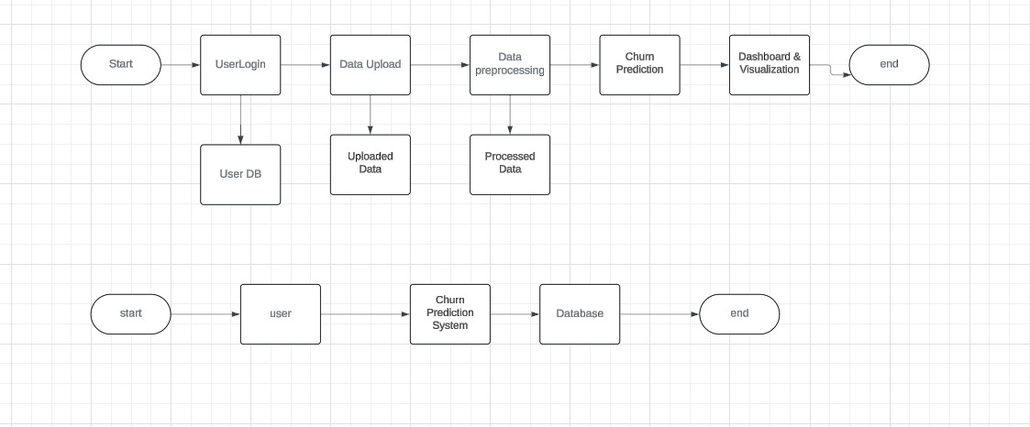
DFD DIAGRAM
LEVEL 0

Slide 21
DFD DIAGRAM
LEVEL 1

Slide 22
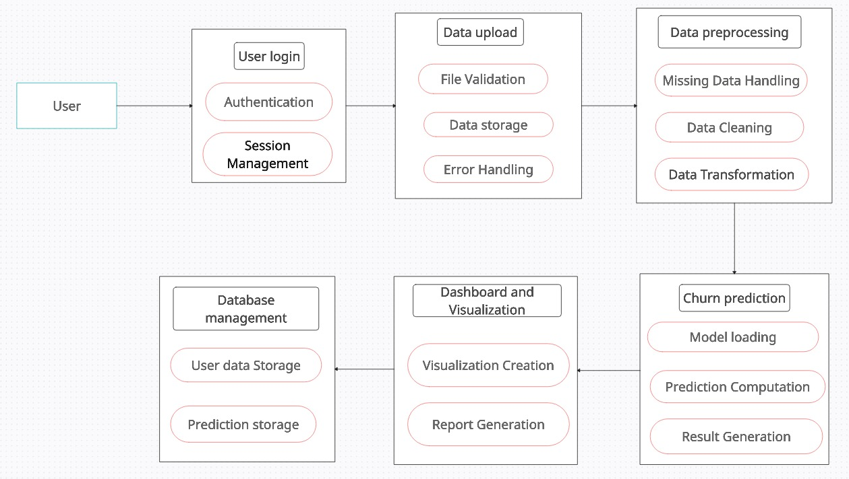
DFD DIAGRAM
LEVEL 2

Slide 23
Functional & Non-Functional Requirements:
Functional Requirements:
1. User Authentication & Authorization: The system should support secure login and role-based access control for users.
2. Data Upload: Users should be able to upload validated CSV or Excel datasets.
3. Churn Prediction: The system should predict customer churn using a machine learning model.
4. Dashboard & Visualization: Users should view churn results through charts, graphs, and visual reports.
5. Report Generation: The system should allow users to generate downloadable churn reports.
Non-Functional Requirements
Performance: The system should process datasets of up to 100,000 records within 2 minutes.
Scalability: The website should scale to handle increased users and data efficiently.
Security : Sensitive customer data must be encrypted both in transit and at rest.
Usability: The interface should be user-friendly and provide clear feedback on actions.
Availability & Reliability: The system should ensure 99.9% uptime with backup and recovery mechanism

Slide 24
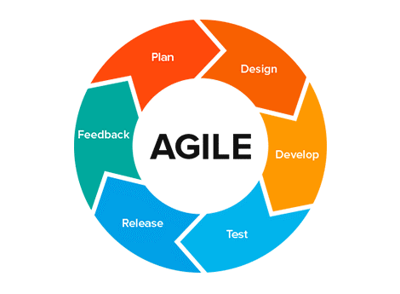
AGILE MODEL
Agile breaks the project into smaller, manageable parts called sprints or iterations. Each sprint delivers a functional piece of the product, allowing teams to respond to feedback and changes quickly.
Agile breaks the project into smaller, manageable parts called sprints or iterations. Each sprint delivers a functional piece of the product, allowing teams to respond to feedback and changes quickly.
Iterative Development: Work is done in short cycles, with each cycle producing a usable version of the product.
Customer Collaboration: Continuous interaction with stakeholders ensures the product aligns with user needs.
Emphasis on Flexibility: Agile welcomes changes, even late in development, to keep the product relevant.

Slide 25
THANK YOU

